Slide 1
Access Control Lists

Slide 2
Objectives
Explain how ACLs are used to secure a medium-size Enterprise branch office network.
Configure standard ACLs in a medium-size Enterprise branch office network.
Configure extended ACLs in a medium-size Enterprise branch office network.
Describe complex ACLs in a medium-size Enterprise branch office network.
Implement, verify and troubleshoot ACLs in an enterprise network environment.

Slide 3
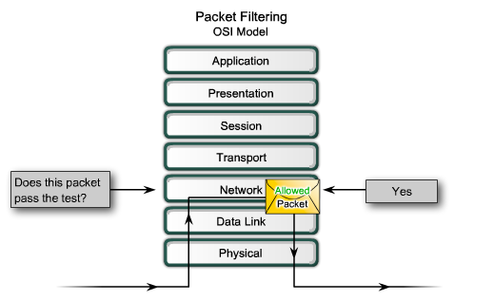
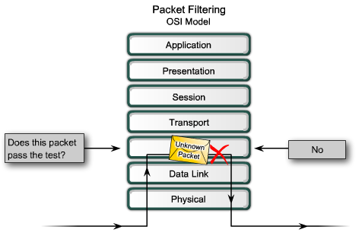
What is the packet filter?

Slide 4
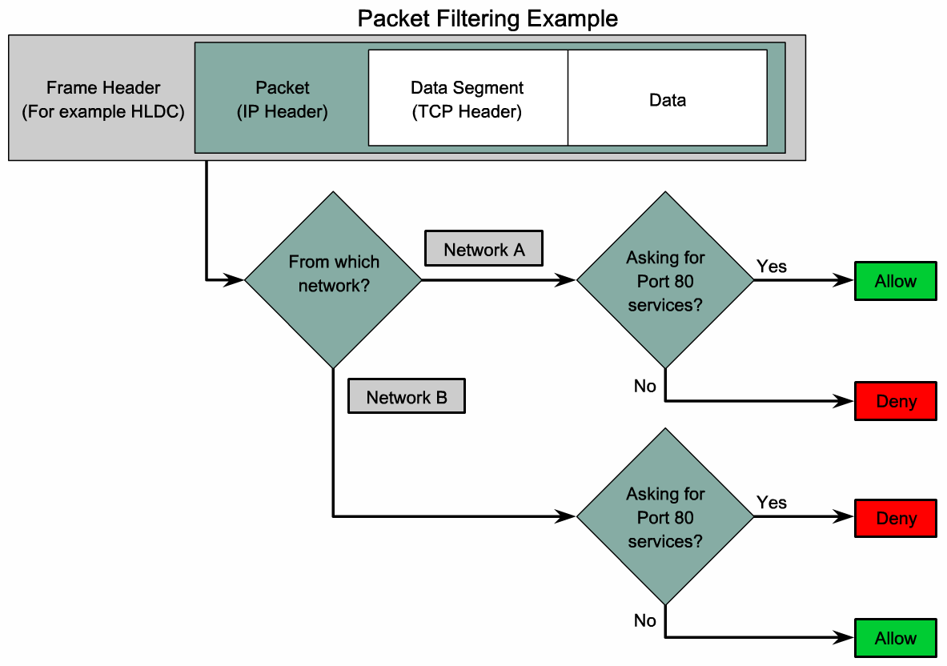
What is the packet filter?
Notes:
Graphic 5.1.2.2

Slide 5
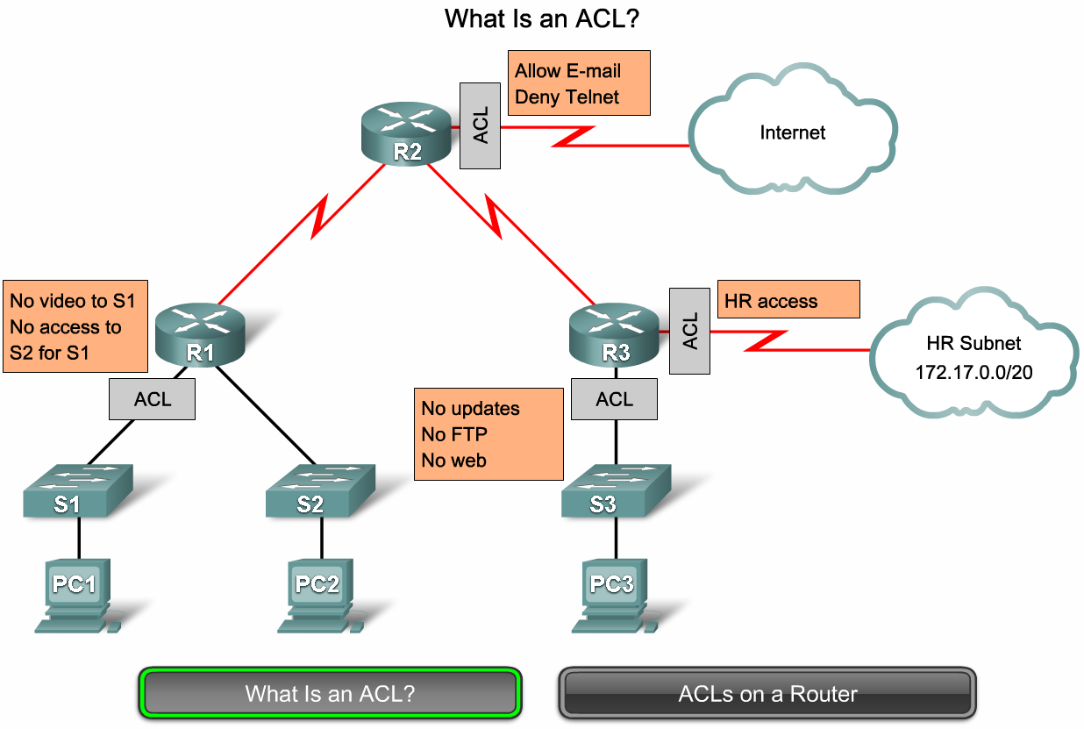
What is an Access Control List (ACL)?
Notes:
Graphic 5.1.3.1

Slide 6
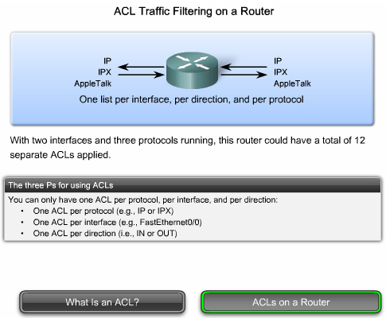
What is an Access Control List (ACL)?

Slide 7
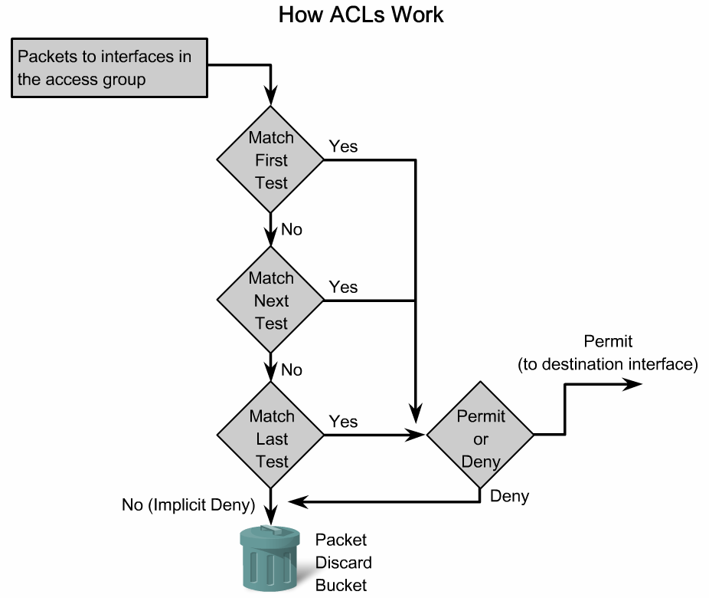
What is an Access Control List (ACL)?
Inbound ACL flow chart
Notes:
Graphic 5.1.4.1

Slide 8
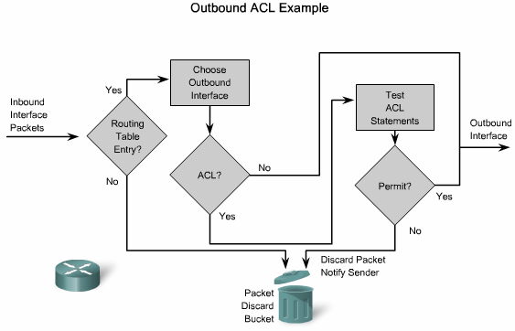
What is an Access Control List (ACL)?

Slide 9
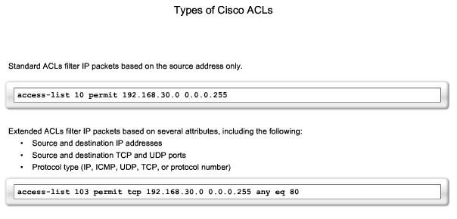
Types of the Access Control List (ACL)
Notes:
Graphic 5.1.5.1

Slide 10
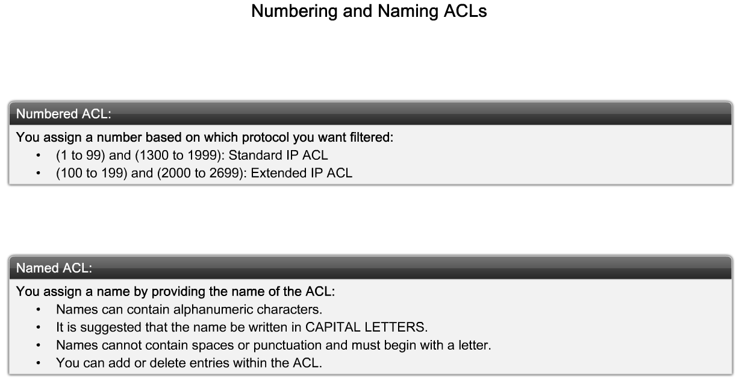
Types of the Access Control List (ACL)
Explain how Cisco ACLs can be identified using standardized numbering or names
Notes:
Graphic 5.1.7.1

Slide 11
Where to place ACL ?
Standard ACL is placed as close the destination as possible.
Extended ACL is placed as close the source as possible.

Slide 12
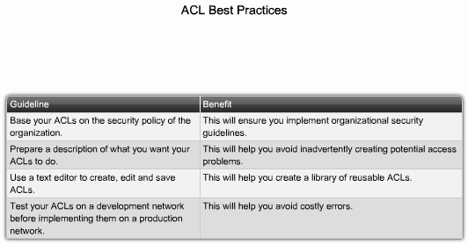
ACL best practice

Slide 13
Access Control List configuration
Firstly : from global configuration mode write you ACL sentences
Secondly : apply the ACL under the interface in the appropriate direction

Slide 14
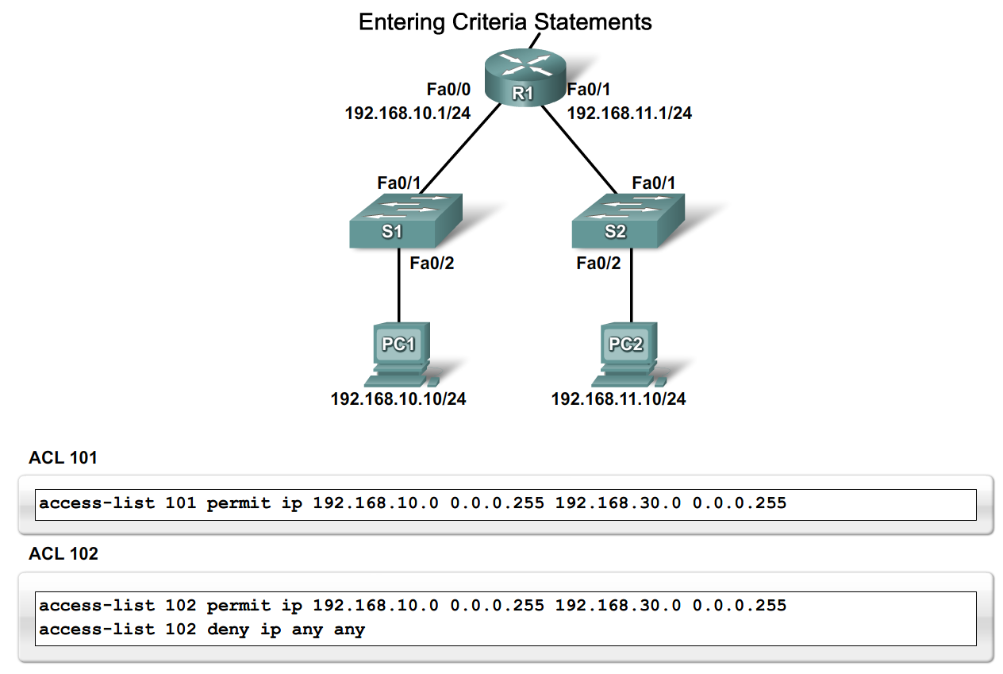
Configure Standard ACLs
Notes:
Graphic 5.2.1.1

Slide 15
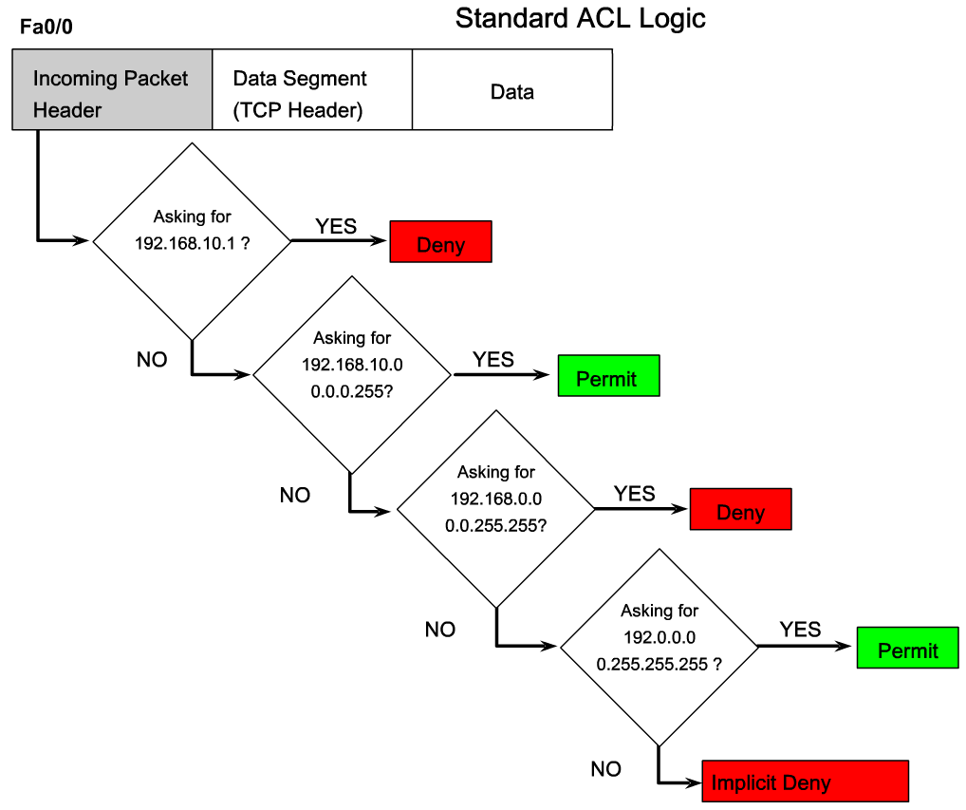
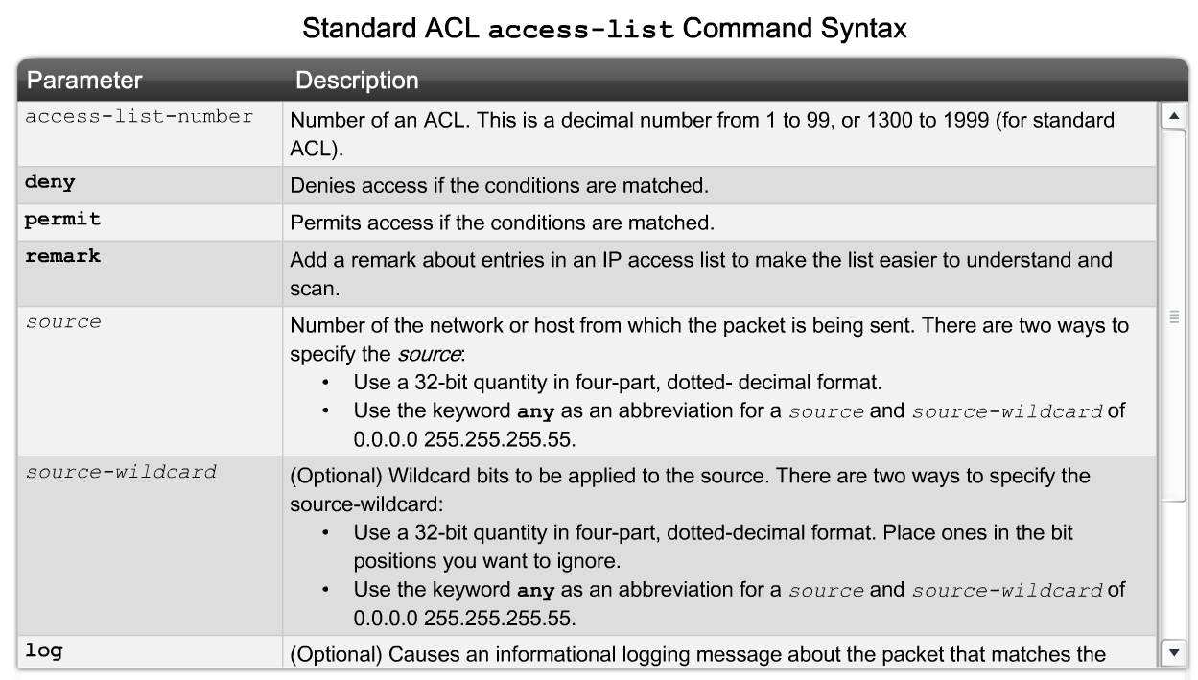
Configure Standard ACLs
Notes:
Graphic 5.2.2.1 & 5.2.2.2

Slide 16
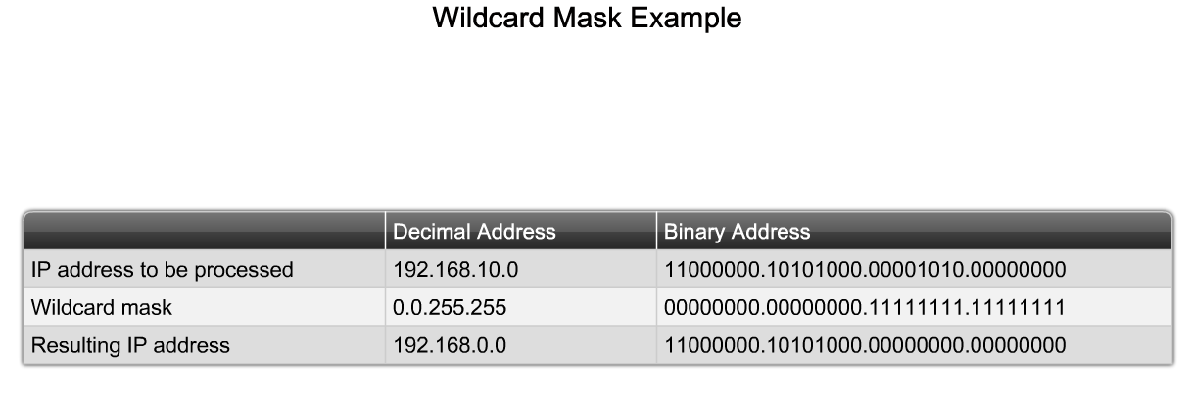
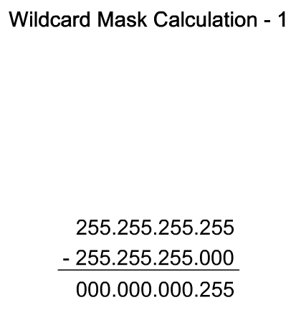
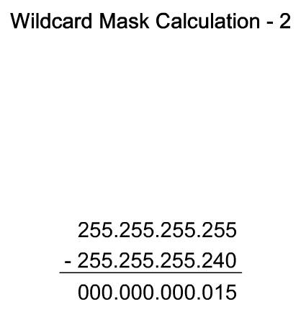
Wild Card Mask (WCM)
Notes:
Graphic 5.2.3.1 & 5.2.3.2 (use the examples), 5.2.3.4

Slide 17
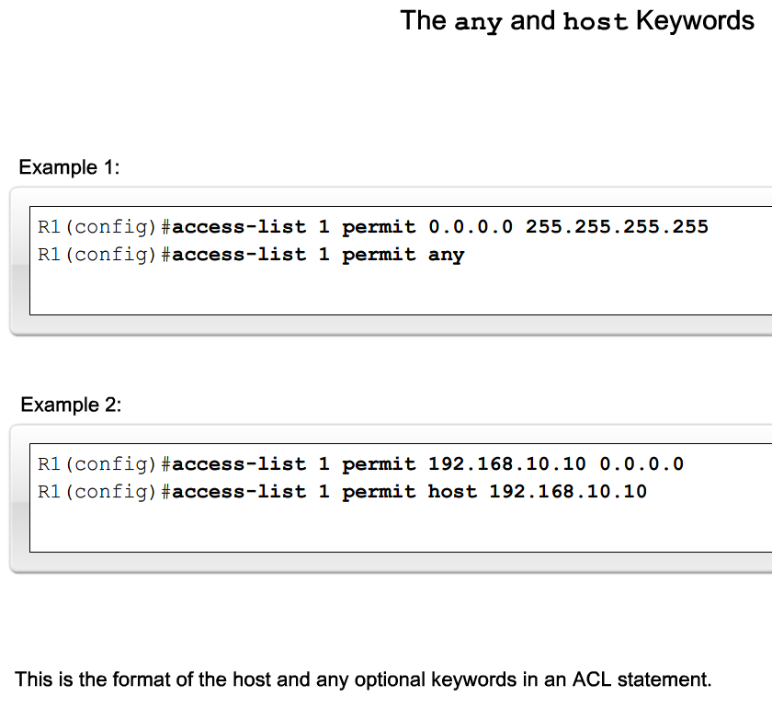
Wild Card Mask (WCM)

Slide 18
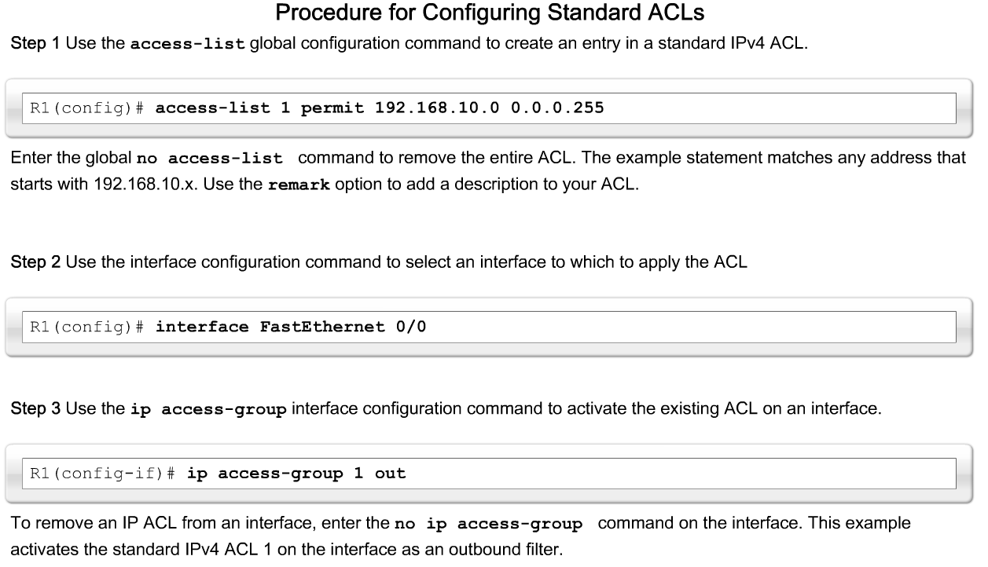
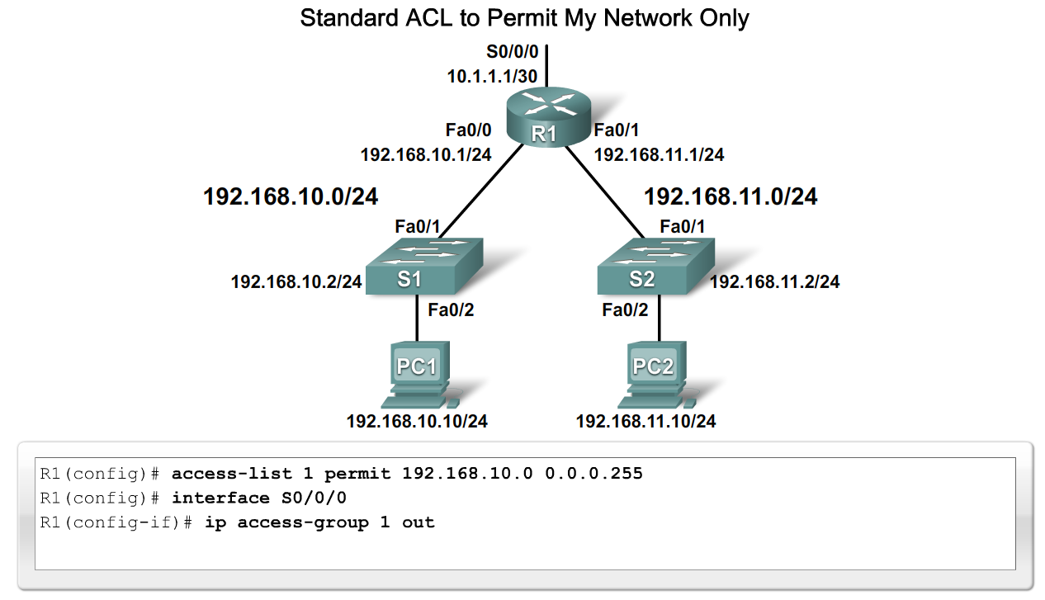
Configure Standard ACLs
Notes:
Graphic 5.2.4.1 (use syntax & one example), 5.2.4.2

Slide 19
Wild Card Mask (WCM)
Write down access-list to deny these hosts
  Hosts 192.167.1.0/24 to 192.167.1.255/24
  all private networks

Slide 20
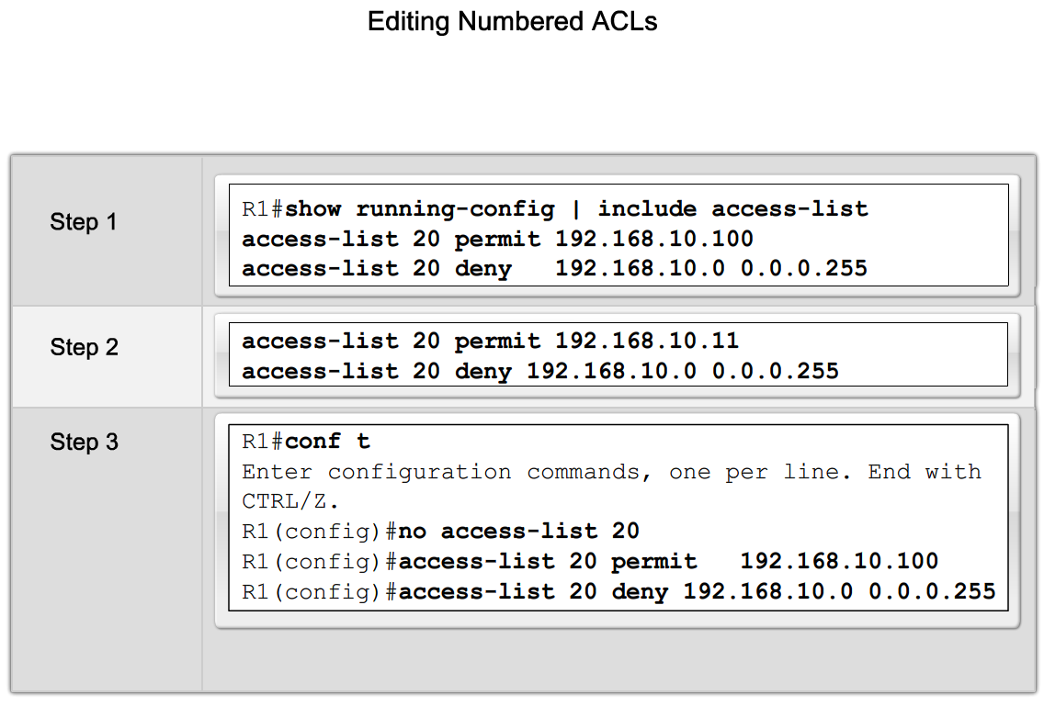
Configure Standard ACLs
Explain the process for editing numbered ACLs
Notes:
Graphic 5.2.5.1

Slide 21
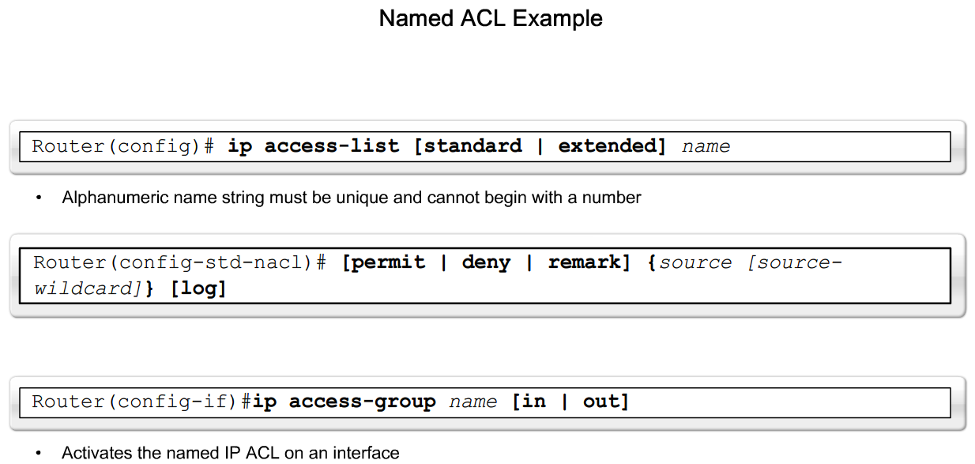
Configure Standard ACLs
Explain how to create a named ACL
Notes:
Graphic 5.2.6.1

Slide 22
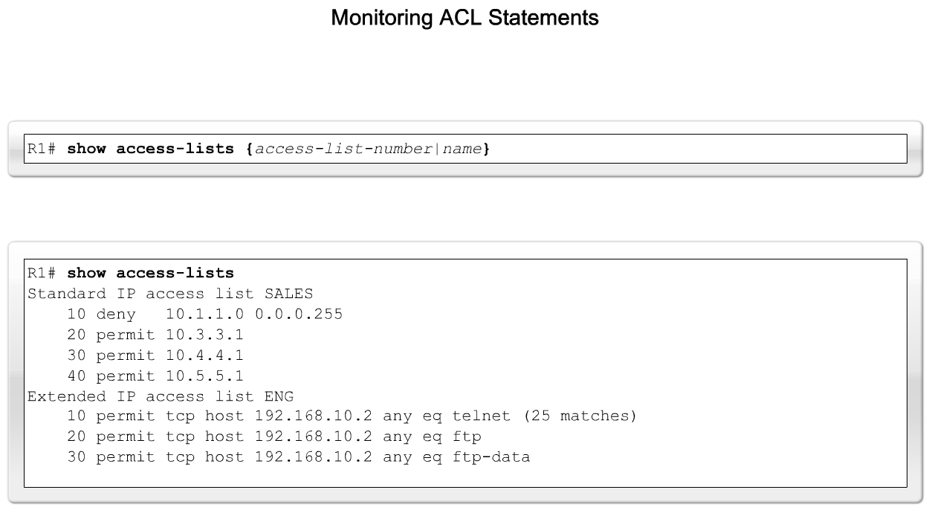
Configure Standard ACLs
Describe how to monitor and verify ACLs
Notes:
Graphic 5.2.7.1

Slide 23
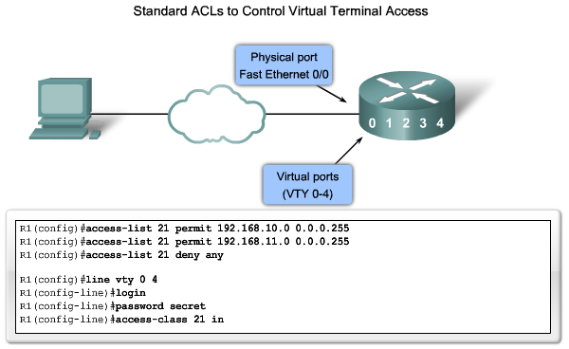
VTY ACL

Slide 24
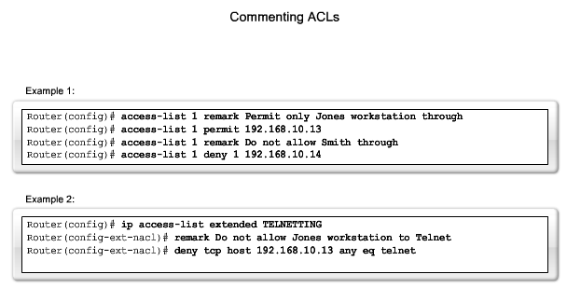
Remarking ACL

Slide 25
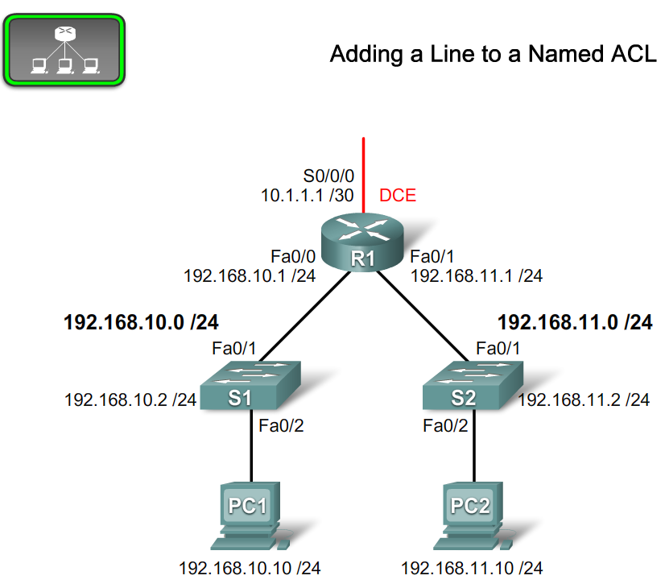
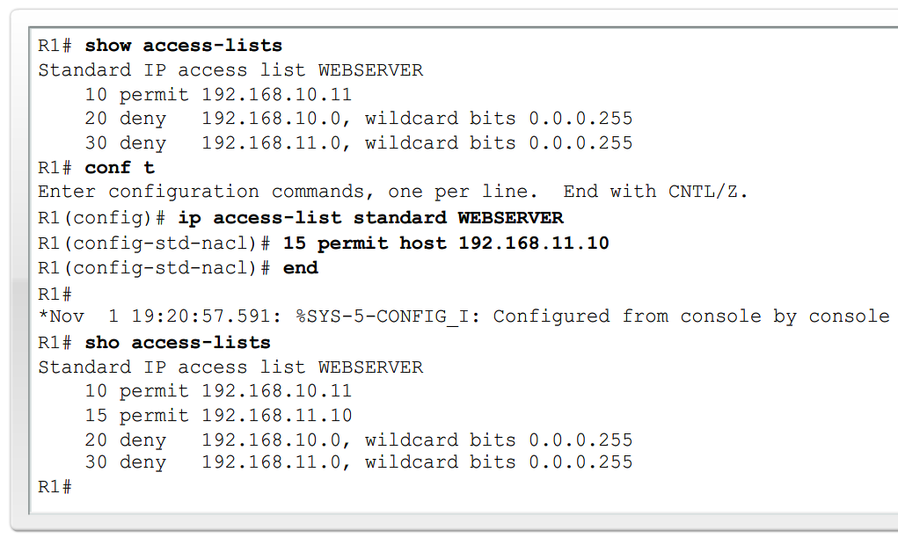
Configure Standard named ACLs
Notes:
Graphic 5.2.8.1

Slide 26
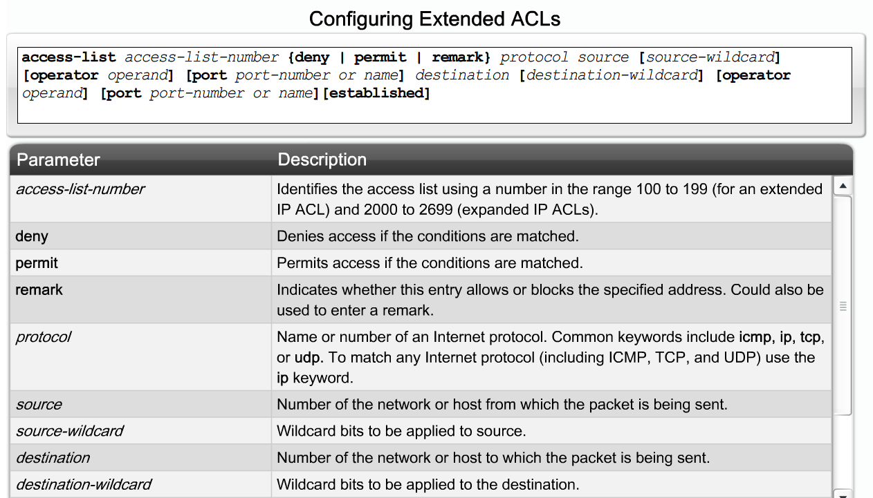
Configure Extended ACLs
Notes:
Graphic 5.3.2.1

Slide 27
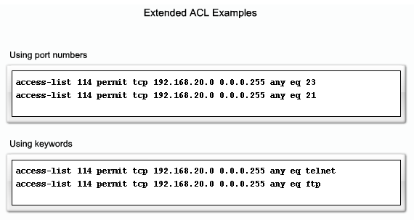
Extended ACL example

Slide 28
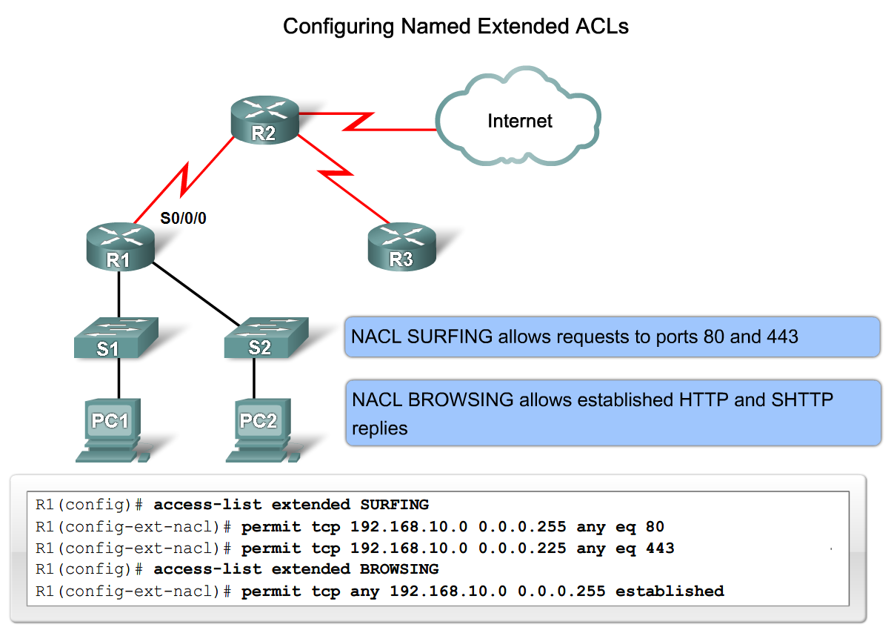
Configure Extended ACLs
Notes:
Graphic 5.3.4.1

Slide 29
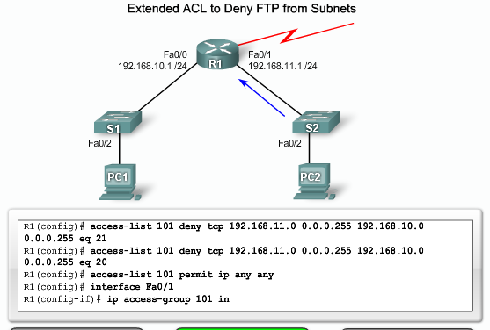
Extended ACL example

Slide 30
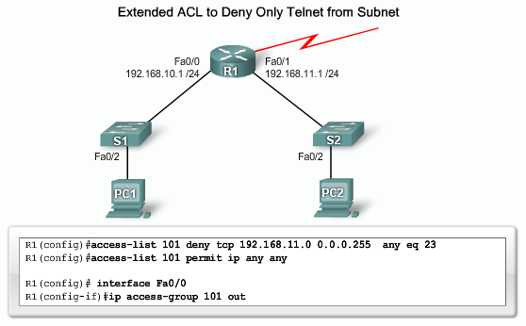
Extended ACL example

Slide 31
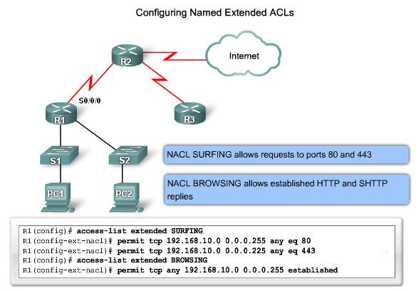
Extended ACL example

Slide 32
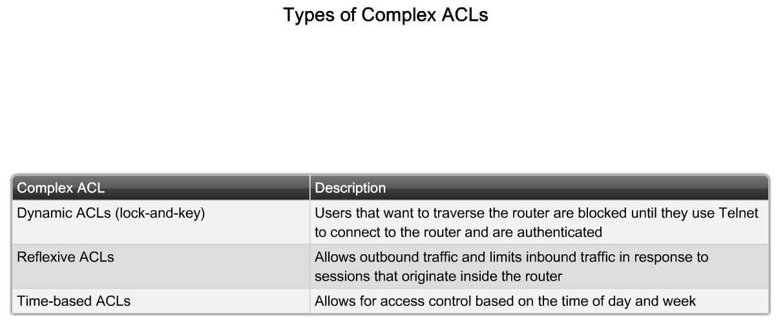
Describe Complex ACLs
List the three types of complex ACLs
Notes:
Graphic 5.4.1.1

Slide 33
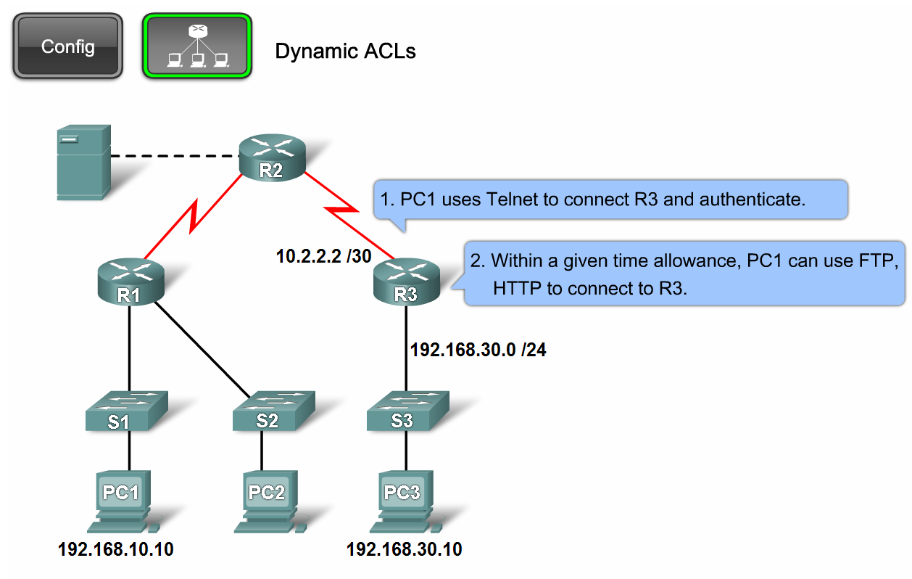
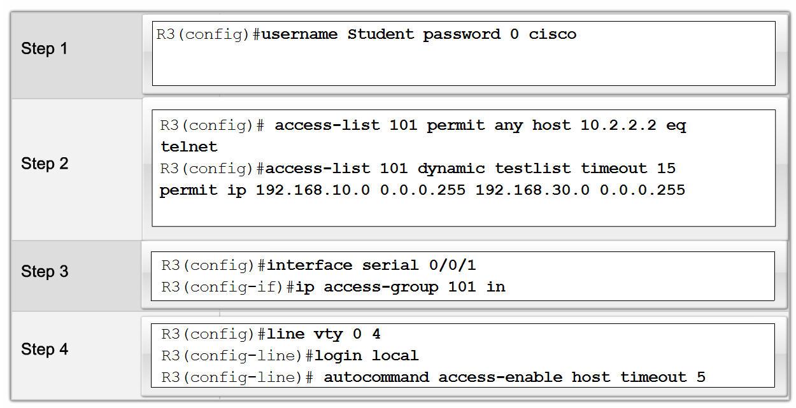
Describe Complex ACLs in a Medium-Size Enterprise Branch Office Network
Explain how and when to use dynamic ACLs
Notes:
Graphic 5.4.2.2

Slide 34
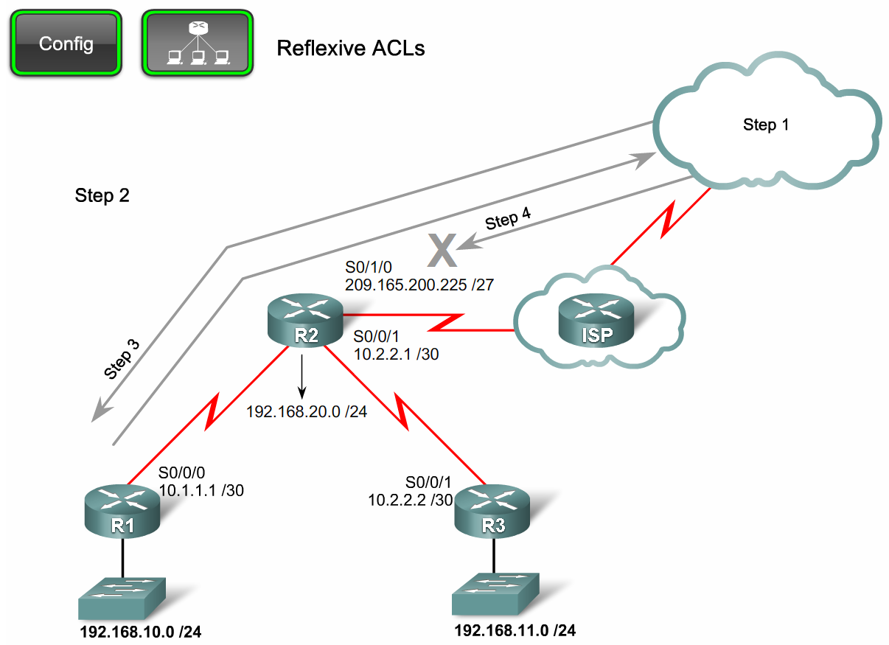
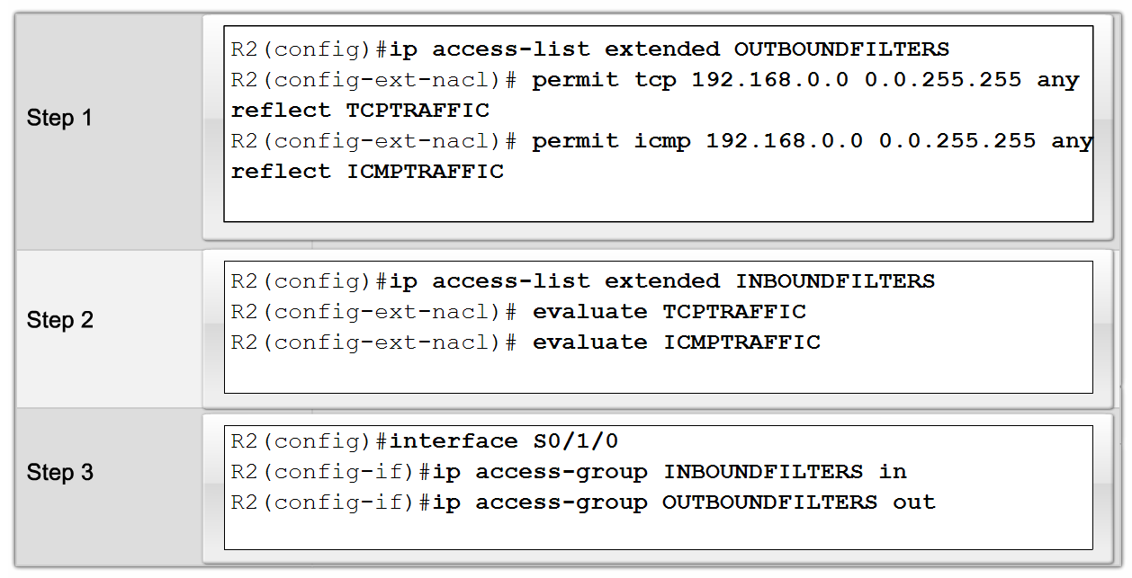
Describe Complex ACLs in a Medium-Size Enterprise Branch Office Network
Explain how and when to use reflexive ACLs
Notes:
Graphic 5.4.3.2

Slide 35
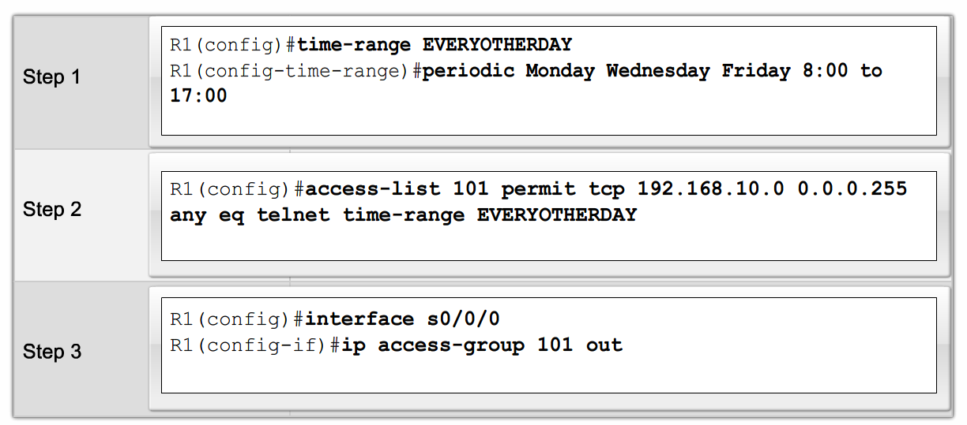
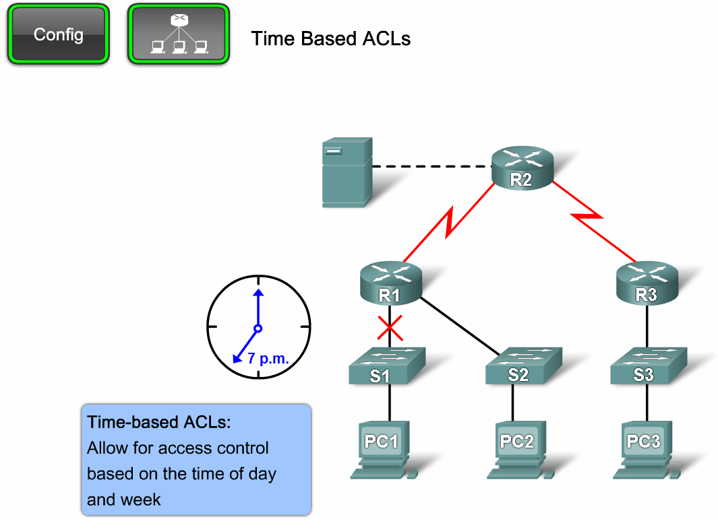
Describe Complex ACLs in a Medium-Size Enterprise Branch Office Network
Explain how and when to use time-based ACLs
Notes:
Graphic 5.4.4.2

Slide 36
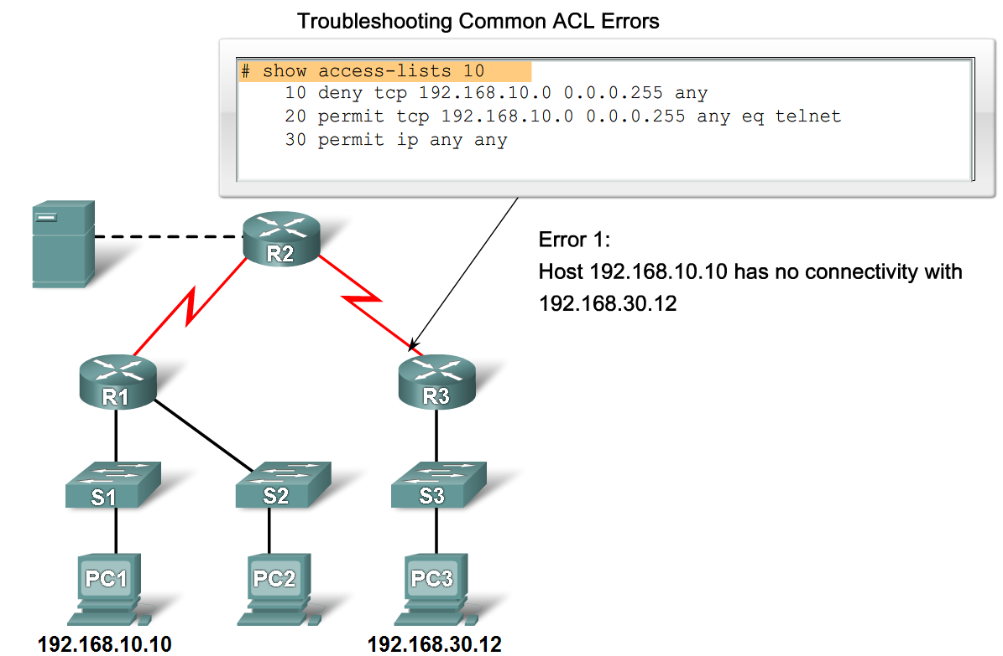
Describe Complex ACLs in a Medium-Size Enterprise Branch Office Network
Describe how to troubleshoot common ACL problems
Notes:
Graphic 5.4.5.1

Slide 37
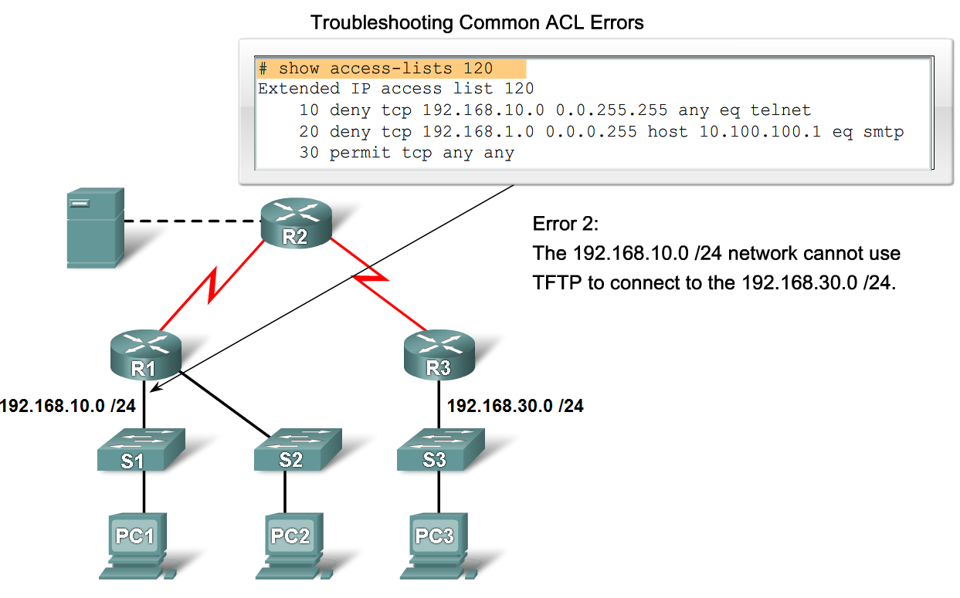
Implement, Verify and Troubleshoot ACLs in an Enterprise Network Environment
Create, place and verify a standard/ extended ACL and verify its placement.
Verify ACL’s functionality and troubleshoot as needed.
Notes:
Not sure what you want here. It looks like this is associated with the lab portion of the chapter. If you’re looking for an objective I would place the following 2 objectives
Create, place & verify an standard/extedended ACL and verify its placement.
Verify ACL’s functionality and troubleshoot as needed.
As far as a graphic is concerned you can use a previous topology (for example the graphic from 5.4.5.1)

Slide 38
Summary
An Access List (ACL) is:
  A series of permit and deny statements that are used to filter traffic
Standard ACL
  Identified by numbers 1 - 99 and 1300 - 1999
  Filter traffic based on source IP address
Extended ACL
  Identified by number 100 -199 & 2000 - 2699
  Filter traffic based on
    Source IP address
    Destination IP address
    Protocol
    Port number

Slide 39
Summary
Named ACL
  Used with IOS 11.2 and above
  Can be used for either standard or extended ACL
ACL’s use Wildcard Masks (WCM)
  Described as the inverse of a subnet mask
    Reason
      0 → check the bit
      1 → ignore the bit

Slide 40
Summary
Implementing ACLs
  1st create the ACL
  2nd place the ACL on an interface
    Standard ACL are placed nearest the destination
    Extended ACL are placed nearest the source
Use the following commands for verifying & troubleshooting an ACL
  Show access-list
  Show interfaces
  Show run

